Slide 1



<NAME OF THE PROJECT>
Pomodoro Timer
IBRAHIM HASSAN
Malak Elfaqir
Python Junior
2023 – 2024
Notes:
1. INTRODUCTION

Slide 2
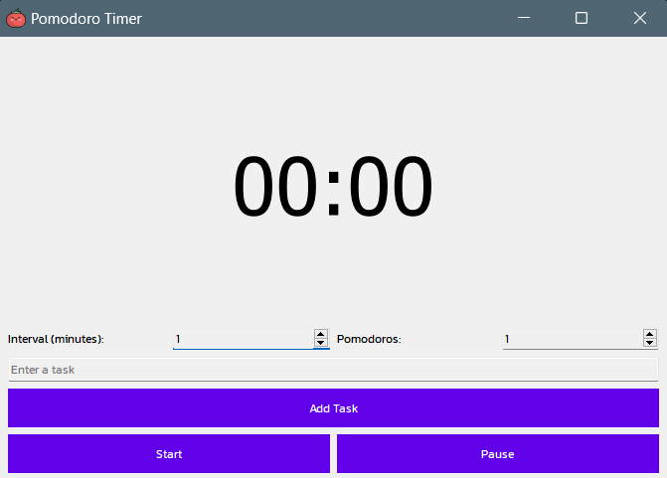
This project is a Pomodoro timer application built using PyQt5, designed to help users manage their time effectively with the Pomodoro Technique.
<NAME OF THE PROJECT>
Key Features Include:
Settings
Task Management
Control Buttons
Notifications
Timer Display
Pomodoro Count
IBRAHIM HASSAN
The concept originates from Francesco Cirillo, creator of the Pomodoro Technique, designed to optimize productivity through structured work intervals, drawing inspiration from a tomato-shaped kitchen timer.

Slide 3


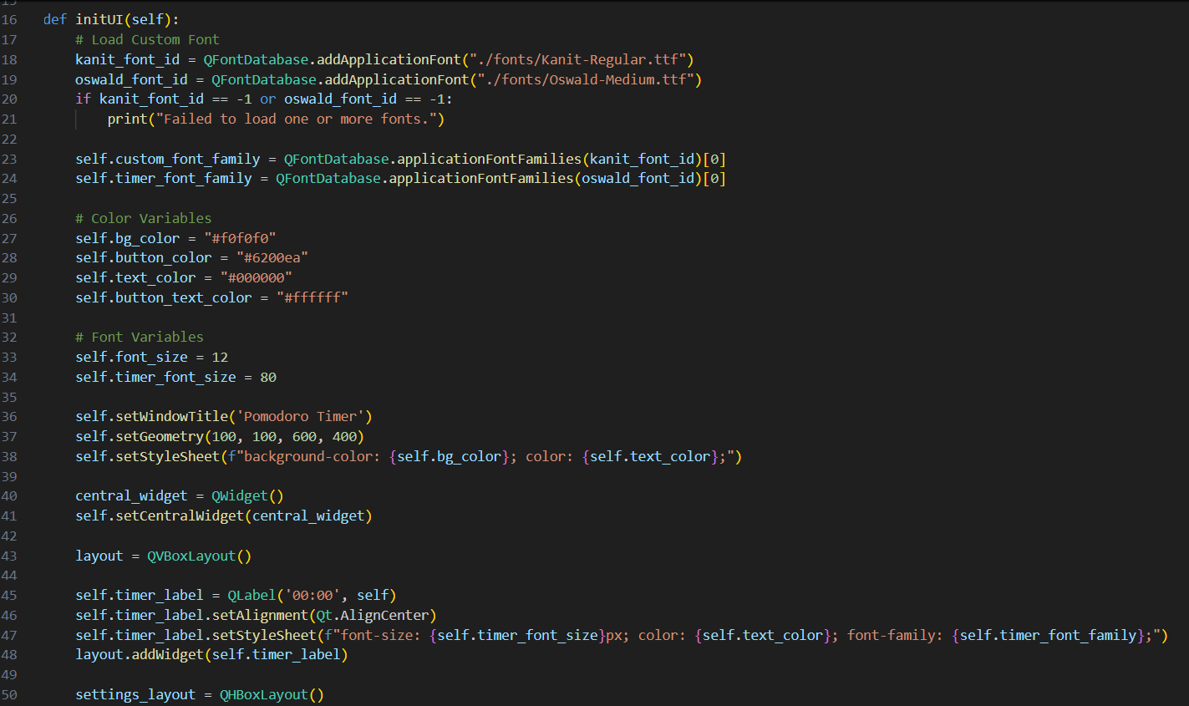
<NAME O
ROJECT>
Visual Studio Code
Python
IBRAHIM HASSAN
Pomodoro Timer

Slide 4
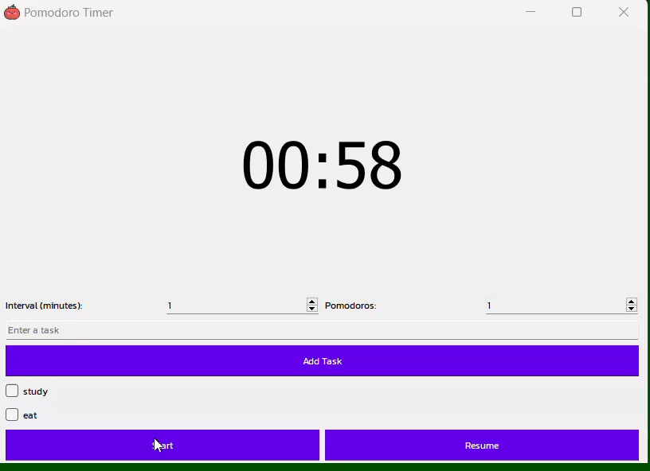
<NAME OF THE PROJECT>
IBRAHIM HASSAN
Enhance your focus with our Pomodoro Timer app, Offering simple task tracking and adjustable Intervals.

Slide 5
<NAME OF THE PROJECT>
Take charge of your productivity with our sophisticated Pomodoro Timer application. Start optimizing your work efficiency today
Malak@Gmail.com
IBRAHIM HASSAN

